Slide 1
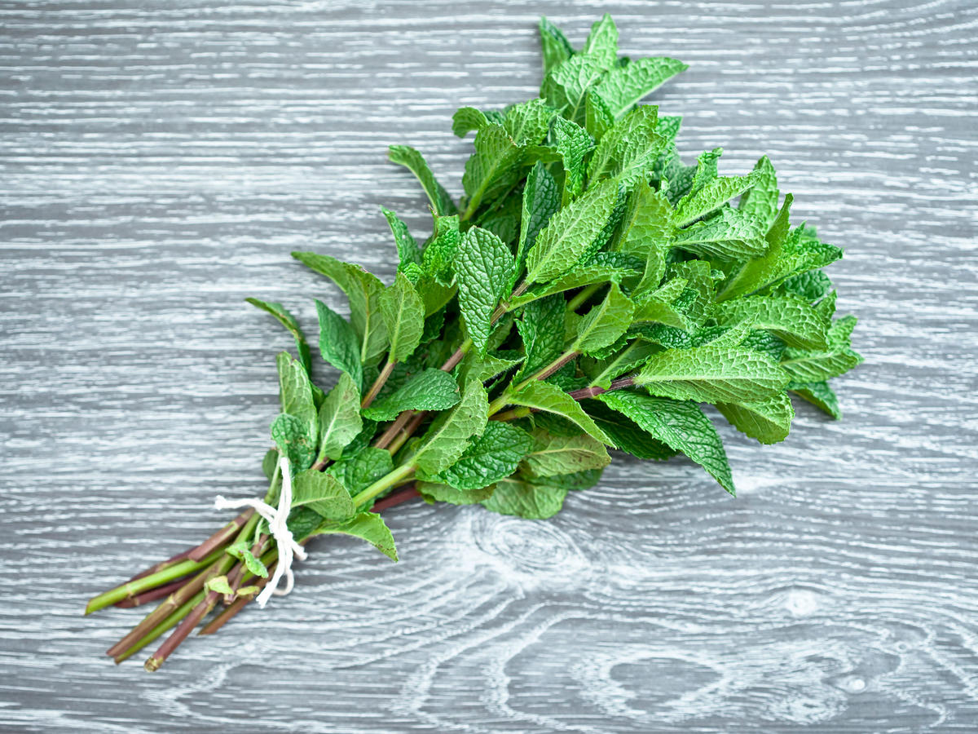
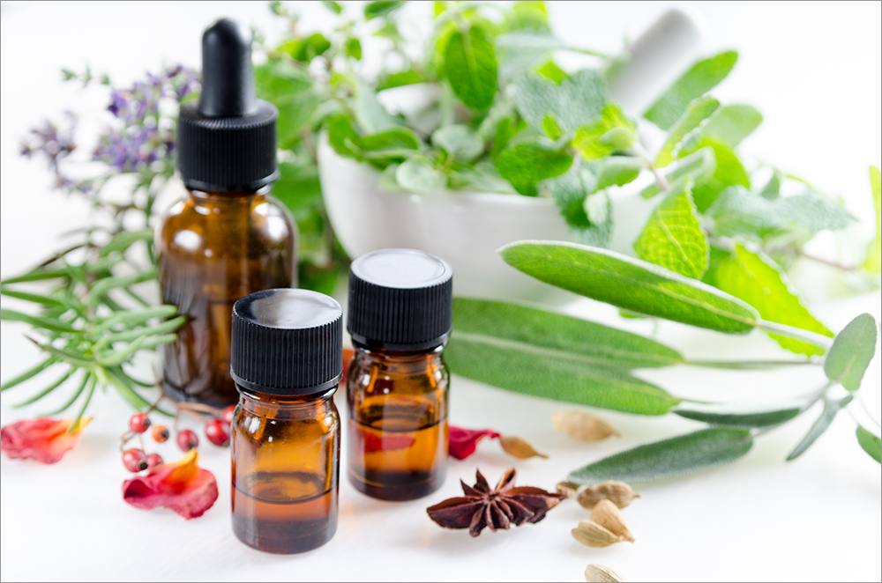
Herbs and Oils: What’s the Latest?
John D. Mark MD
Russell Wise PharmD

Slide 2
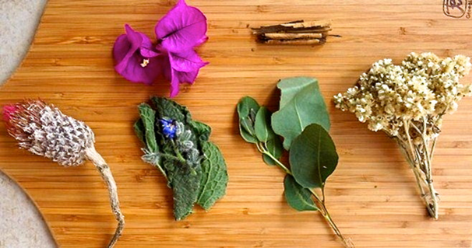
Case 1
SJ is a 10 yr-old male diagnosed with CF at 5 months of age
Genotype: ΔF508/ΔF508
Family history positive for CF on maternal side
Social history: SJ is the 4th of 7 children, family is Amish
Only child known to have CF
Lives on the family farm, which is the main source of income
Parents, especially dad, question prescribed treatments
Parents often give SJ “natural” supplements

Slide 3
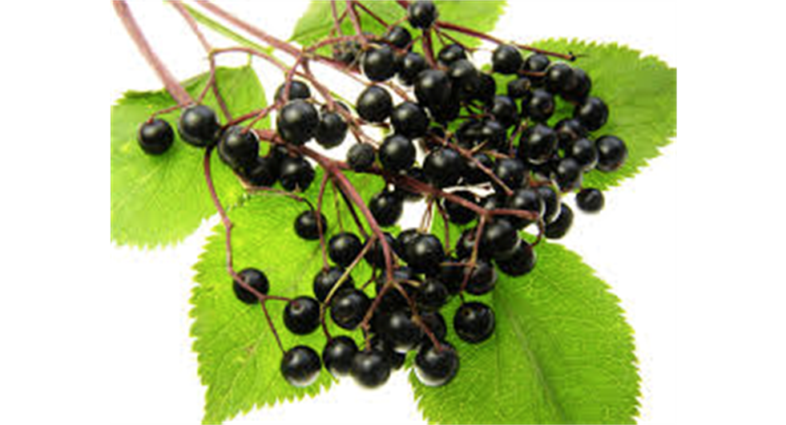
Case 2
4 yr diagnosed on newborn screen- mutation: CFTR mutations 2055del19A / 3199del6
On usual therapies including airway clearance, pancreatic enzymes, ADEK vitamins and occasional oral antibiotics (no Pseudomonas or MRSA).
Parents interested in keeping her “healthy” and started her on supplements:
Nutratose: contains eight essential sugars which is felt to support the immune system and is a blend of Cordyceps, Maitake and Shiitake, Mannans (plant polysaccharide), Astragalus, Glucosamine, Arabinogalactin, Aloe Vera, Anogeissus latifolia, Cyamopis tetragonolaba, Native Rice Starch .
Host Defense: thought to increase human Natural Killer (NK) Cell activity using activated organic mushrooms and the proprietary combination of species.

Slide 4
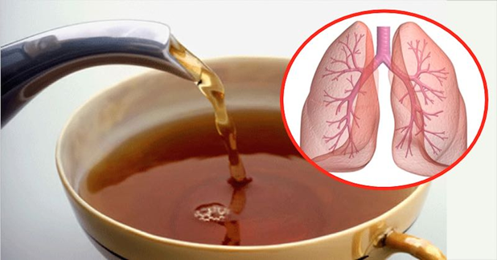
Case 2: cont:
Vitalzym: thought to help to maintain normal enzyme levels for alleviating chronic pain and inflammation
Proteolytic enzymes – Protease, Serrapeptase, Nattokinase, Bromelain, Papain, Amia, Rutin, C0Q10, Magnesium
Spirulina: is a blue-green algae and is 65 to 71 percent protein, with all essential amino acids
Spirulina, Vit A (3,000 U), Vit K (17 mcg), Vit B12 (1.8 mcg), Iron (1 mg), Na (35 mg), Potassium (50 mg)

Slide 5
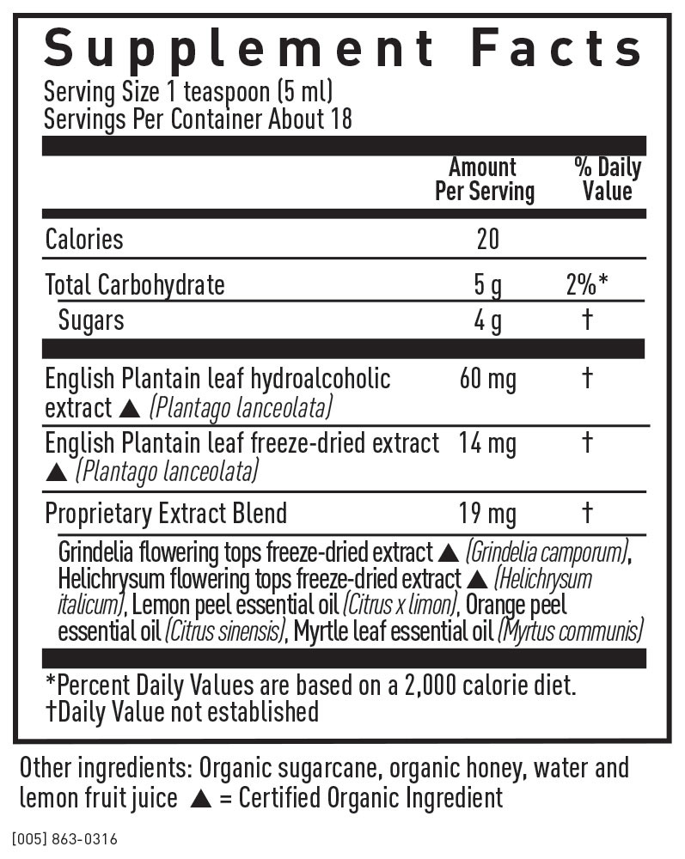
Case 3 (similar story)
Daily: Echinacea and Goldenseal, Elderberry, Barlean’s omega swirl (fish, flax borage), Grapefruit Seed Extract, Hemp Oil (omega 6 and omega 3), Palm Oil, Coconut Oil, and Probiotics
When sick:
Wellness Herbal for Kids, prn cough
Bronchial Wellness Kids (see insert)
Kung F’u Fighter kids (Usnea lichen, Bee Propolis, Myrrh gum,Calendula flower, Boneset aerials, Echinacea Purpurea root, Cinnamon bark
Teas (usually if coughing or congested: Yerba Santa, mullein, mint, linden flower, chamomile, elder flower

Slide 6
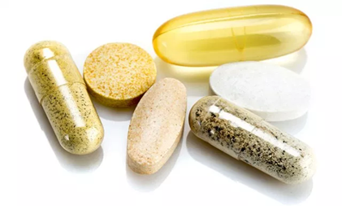
Supplements and children (USA)

Slide 7
Dietary Supplement Use in Children?
Commonly given to children, especially with chronic problems
Children differ from adults in their absorption, distribution, metabolism, and excretion of some substances.
Few studies have been done in children investigating dietary supplements, and even fewer for treating CF-related problems.
Many supplements have traditionally been used by herbalists, eclectic physicians, and naturopathic physicians for respiratory conditions.
Recommended that families consult with specialists for advice before the parents start to use various complementary therapies.
Woolf AD. Pediatrics. 2003.

Slide 8
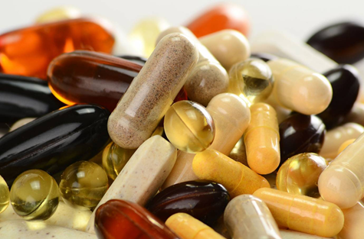
CF Herbs- All sorts are recommended
Herbs to thin out and decrease mucus production
Burdock root (Articum lappa)- balances out oil and water ratio
Comfrey (Symphytum officinale) - Decreases mucus, strengthens lung tissues
Elecampane(Inula helenium)- If an infection is present
Skullcap (Scutellaria lateriflora)-To relax airways, decrease coughing
Turmeric (Curcuma longa)-Thins secretions, decreases inflammation in airways.
Herbs to boost immunity
Astragalus (Astragalus membranaceus)
Garlic (Allium sativum)
Bladderwrack (Fucus vesiculosus)
Nettles (Urtica diotica)
Reshi Mushroom (Ganoderma lucidum)
Two current popular supplements are essential oils and Indrepta C

Slide 9
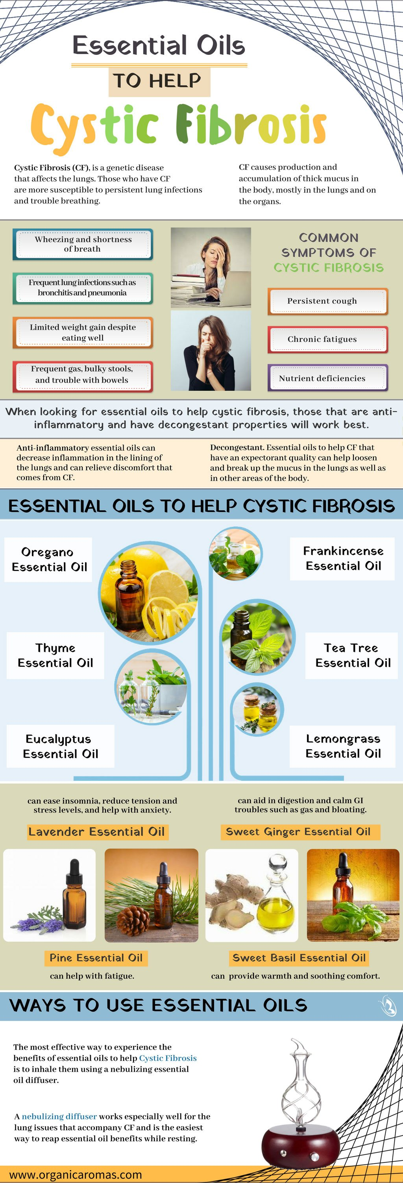
Why Essential Oils in CF?
Early therapies are felt to be important to manage the symptoms and treat CF.
Essential oils are thought to be anti-inflammatory and have decongestant properties.
May help with GI issues for inflammation in the pancreas and gut.
Essential oils help also as an expectorant to loosen and break up the mucus in the lungs as well as in other areas of the body.
The common essential oils to help with cystic fibrosis include:
Frankincense Oil, Eucalyptus Oil, Tea Tree Oil, Lemongrass Oil, Thyme Oil, and Oregano Oil

Slide 10
Indrepta C
A formulation of natural ingredients that have been reported to help lung function by improving CFTR function
Turmeric (curcumin)
Trans-Resveratrol
Amentoflavone
Quercetin dihydrate
Bioperine™
Silymarin
EGCG (Camellia sinensis)
Hawthorne fruit
Hawthorne leaf
Forskolin
Boswellic acid
Escin
Notes:
“C” formulation adds curcumin, escin, Boswellic acid

Slide 11
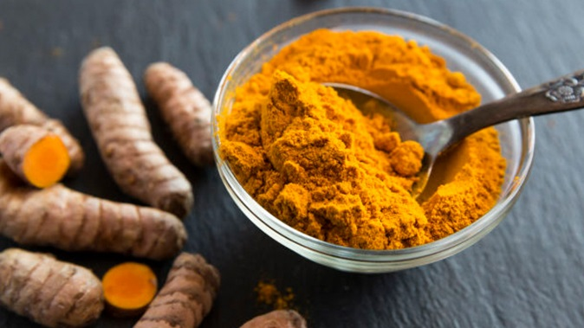
Curcumin
Component of tumeric
Use: Anti-inflammatory, antioxidant, bone/joint health, antidepressant
Claim: W1282X can be activated my curcumin
In vitro with the addition of ivacaftor for W1282X
Ivacaftor + curcumin showed additive effects on CFTR channel activity
Does not translate in vivo where the amount of polypeptide is limited
Can effective doses of curcumin in vivo be achieved?
Bioavailability: very poor oral absorption
Interactions: CYP3A4
Kalydeco, Orkambi, Symdeko
Voriconazole, posaconazole
Erythromycin, rifampin
Notes:
Low systemic bioavailability following oral dosing
CYP2D6?
Anti-inflammatory dosing: 250-500 mg/kg in rats
Dose range: 500 mg BID – 8 g/day; GI adverse effects with higher dosing
Hydrophobic and cannot be given IV

Slide 12
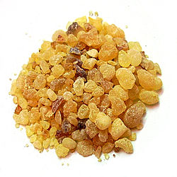
Boswellia serrata
AKA: frankincense
Common uses: anti-inflammatory, anti-diabetic, antimicrobial, dermatological ailments
Indrepta claim: anti-inflammatory and anti-asthma
Double-blind, placebo-controlled, 6-week clinical study (1998 abstract)
Inhibits leukotriene biosynthesis: 300 mg TID (900 mg/day)
80 patients total in study
70% of treatment patients showed improvement in asthma symptoms
Decrease in dyspnea, rhonchi, number of attacks, and increase in FEV1
27% of patients in placebo group showed improvement
Indrepta C formulation: 500 mg/day

Slide 13
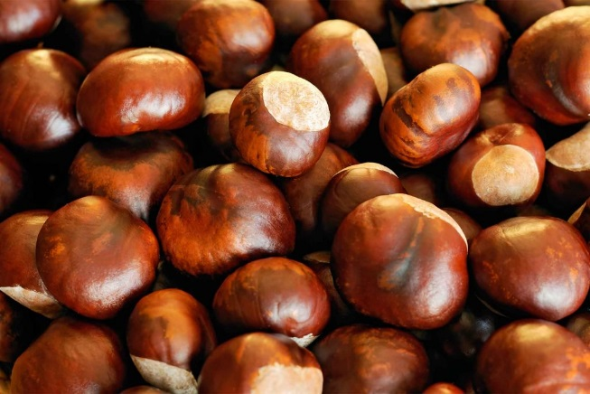
escin
AKA: horse chestnut
Use: anti-inflammatory, vasoconstrictor, vasoprotective, chronic venous insufficiency
Indrepta claim: can suppress nonsense mutations, promoting read through of full-length CFTR
Notes:
Ivacaftor added to agents
Escin consistently induced readthrough activity as demonstrated by enhanced CFTR expression and function in vitro
May be suitable to advance to human testing

Slide 14
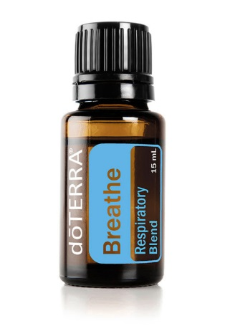
Do terra Breathe, Essential Oils
Respiratory Blend
Laurel Leaf, Eucalyptus Leaf, Peppermint Plant, Melaluca Leaf, Lemon Peel, Cardamom Seed, Ravintsara Leaf, Racensara Leaf essential oils
Diffuser
$30/bottle (15 mL)
Caution: skin sensitivity
doTerra states: feelings of clear airways and easy breathing

Slide 15
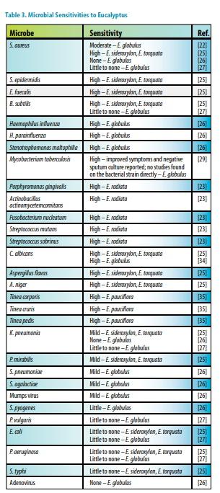
Eucalyptus oil
Use: anti-microbial, anti-inflammatory, mucolytic, bronchodilator, blood glucose control
Interactions: may inhibit or induce CYP metabolism enzymes
CF medications: Kalydeco, Orkambi, Symdeko, clarithromycin, rifampin, voriconazole, posaconzole
2010 Review Article
No formal correlation between the amount of major constituents and the antibacterial activity has been determined
2018 Review Article
1 study reporting use in relieving coughing, expelling mucus, and relaxing respiratory muscles
Notes:
Death has been reported with ingestion in as little as 4 mL
Rapid GI absorption

Slide 16
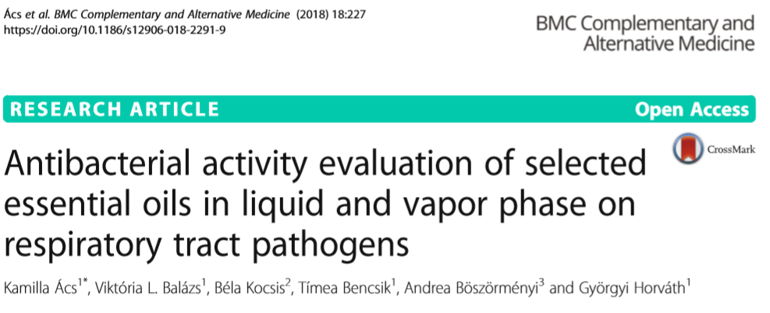
Notes:
“In vitro and clinical studies are also required to calculate the effective doses of essential oils, determine the interactions between components and reveal their toxicity.”

Slide 17
FDA

Slide 18
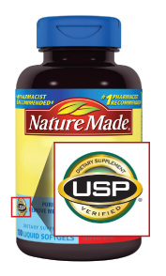
FDA and dietary supplements
Dietary supplements are regulated by the FDA, however, under a different category than OTC and prescription drug products
Manufacturers are prohibited from marketing products that are adulterated or misbranded
GMP (Good Manufacturing Practice)
Companies are required to produce and test products in a way that eliminates contamination and ensures that ingredients match the label
USP
Establishes quality standards for all OTC medicines to reflect those of FDA approved products
GRACE
Generally Recognized as Safe and Effective
List of products on website
Notes:
Adulterated: product is unsafe
Misbranded: labeling is false or misleading

Slide 19
What to do? First: Practice Culturally Sensitive Care
Different health care beliefs and practices
Perception of illness as a failure to function in the work role
May not believe in immunizations or preventive health care
Both traditional and nontraditional health care providers and treatments are used
Lifestyle preferences that may influence health care practices
Limited use of technology
Limited access in tradition education
Isolation from mainstream society
Mistrust of the “American system”
Adams CE, Leverland MB. Nurse Pract. 1986.
Dellasega C et al. Clin Excell Nurse Pract. 1999.

Slide 20
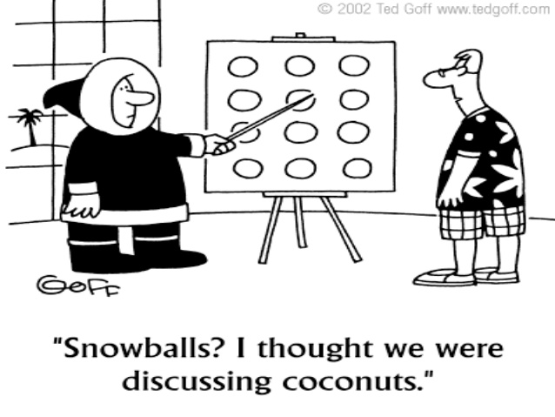
Culture and Health Care
Supplement, adapt, and revise current practices in order to provide comprehensive care that is culturally sensitive and acceptable to patients
Learn the culture
Avoid making assumptions and stereotyping
Validate cultural beliefs and practices; express openness to incorporate alternative health care approaches when possible
Develop a relationship
Promote feelings of trust and safety in a culturally sensitive environment
Present new ideas and practices slowly
Treat patients with respect and honesty
Individualize care
Realize that each individual within the culture has unique beliefs
Dellasega C et al. Clin Excell Nurse Pract. 1999.

Slide 21
Remember Supplement Safety
FDA just launced a tougher oversight of supplements
4,000 products and $4 billion a year in sales to as many as 80,000 products and $50 billion in sales
23,000 emergency department visits in the United States every year were attributed to adverse events related to dietary supplements
Three out of four Americans take a dietary supplement on a regular basis
One in three children also take supplements
Increasingly, officials and public health experts have become concerned about unsafe ingredients — such as the active ingredients in drugs, often from overseas — showing up in supplements

Slide 22
Red Flags
Be alert for these red flags:
Big promises. Advertisements call the product a "miracle cure," "scientific breakthrough," "secret ingredient," "ancient remedy" or "revolutionary discovery."
Pseudomedical jargon. Although terms such as "purify," "detoxify" and "energize" sounds impressive, generally used to cover up a lack of scientific proof.
Cure-alls. The manufacturer claims that the product can treat a wide range of symptoms or cure or prevent a number of diseases.
Testimonials. Anecdotes from individuals who have used the product are no substitute for scientific proof.
Guarantees and limited offers. Used to get you to buy before you can evaluate the product's claims.

Slide 23
Safe and effective
Guide to CAM treatment recommendations. (Reproduced with permission from Kemper K, Cohen M. Ethics meet complementary and alternative medicine: new light on old principles. Contemp Pediatr.2004;21:65.)

Slide 24
Thanks- all need to work together!

